Slide 1

VISUALISING ROAD SAFETY ENFORCEMENT DATA IN AUSTRALIA
UNIT CODE:
PRESENTED BY:
COS30045
DV_Group20

Slide 2


Our team
Name:Lalmuanpuia
Name:Nyi La Min
Student ID: 105735572
Student ID:105735

Slide 3

Background, Motivation & Purpose
Background
Road safety remains a national issue in Australia.
The Australian Government collects police enforcement data (breath & drug tests) to monitor safe road use.
Motivation
To identify patterns and differences between jurisdictions.
To raise public awareness of how enforcement contributes to road safety.
Purpose
To visualise and compare road safety enforcement across Australian regions.
To explore how police enforcement activities vary across Australia’s states and territories.

Slide 4
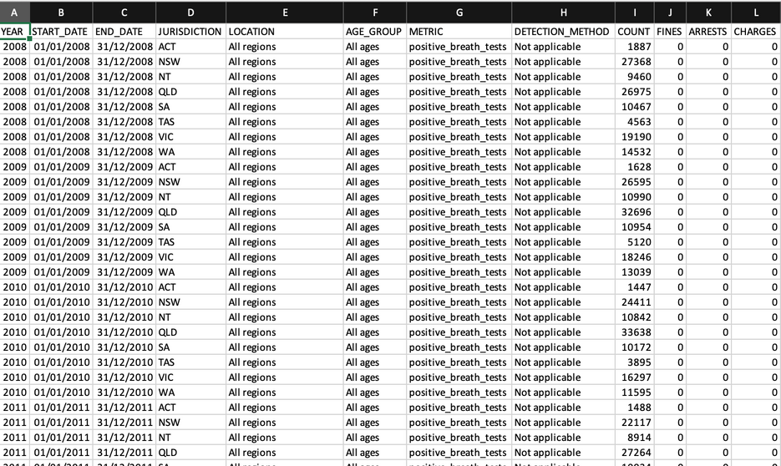
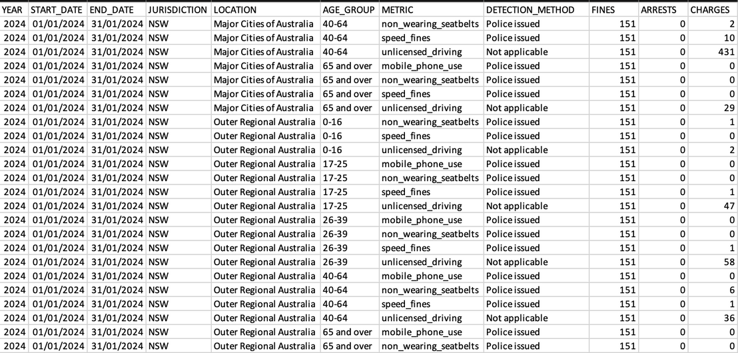
Data Source
Title | Police Enforcement Data/ Infrastructure Statistics
Source | https://datahub.roadsafety.gov.au/safe-systems/safe-road-use/police-enforcement https://www.bitre.gov.au/publications/2025/australian-infrastructure-and-transport-statistics-yearbook-2024
Format | Excel Files (4 datasets)/ PDF ( Annual Driver License Data)
Years Covered | 2008-2014
Dataset Names | Alcohol and Drug Tests Fines Positive Breath Tests Positive Drug Tests
Positive Breathe Tests
Police Enforcement Fines

Slide 5
Understanding Data Dictionary
About the Data
Key Fields
Collected from state and territory police agencies across Australia.
Records enforcement activities such as breath tests, drug tests, fines, arrests, and charges.
Data coverage varies between jurisdictions; some provide only partial data.
Updated in 2023 to include:
Monthly granularity
Age groups
Remoteness areas
Detection methods
Unlicensed driving
Field | Type | Note
Start/End date | Category | Period of offence (DD-MM-YYYY)
Jurisdiction | Category | State or territory
Detection Method | Category | How data was collected
Metric | Measure | Type of enforcement activity
Fines/Arrests/Charges | Numeric | Number of enforcement actions
Notes
Some states use proxy counts (sum of fines and charges) due to missing data.
Data is subject to revision and may differ across jurisdictions.

Slide 6
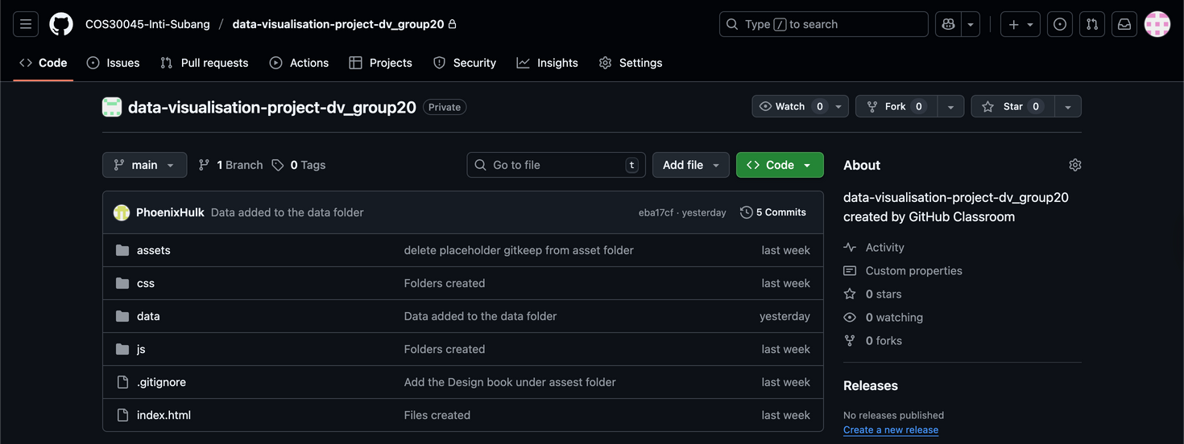
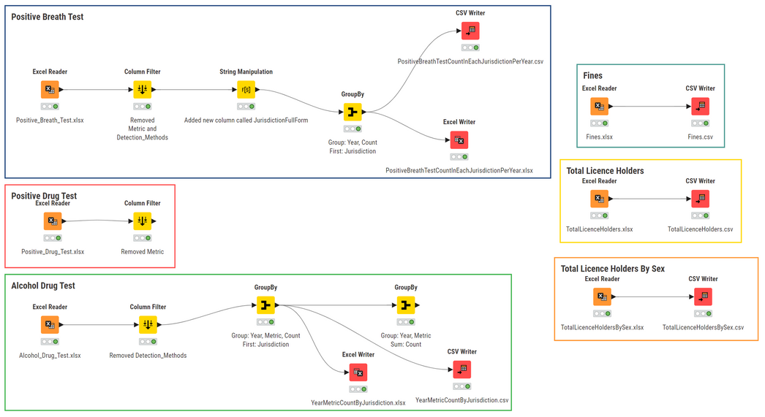
Progress & Evidence
GitHub
Team repo (DV_Group20) created with different folders.
Dataset
Downloaded Police Enforcement Data from Datahub.gov.au (4 Excel files).
Processing
GitHub Repository
Loaded into KNIME; started cleaning and created five new CSVs.
Book
Drafted Introduction and Data section.
Website
Set up a skeleton website to host the visualisations.
Knime Workflow

Slide 7
Challenges & Next Steps
Challenges
Next Steps
Understanding the data was quite challenging since it is not clearly stated.
Data for driver licence holders is not included in the enforcement datasets and must be sourced separately.
Some datasets contain redundant columns, such as Detection Method marked “Not applicable” in several files.
Finalise KNIME workflow for data cleaning and analysis.
Design and generate charts and maps for key insights.
Integrate visualisations into the project website.
Refine interactive features and improve user experience.
Conduct final testing and prepare the report & presentation.

Slide 8

Thank
You!

